Slide 1
RESTful Web Services

Slide 2
What Are Web Services?
Web services are client and server applications that communicate over the World Wide Web’s (WWW) HyperText Transfer Protocol (HTTP).
As described by the World Wide Web Consortium (W3C), web services provide a standard means of interoperating between software applications running on a variety of platforms and frameworks.
. Web services can be combined in a loosely coupled way to achieve complex operations. Programs providing simple services can interact with each other to deliver sophisticated added-value services.

Slide 3
Types of Web Services
On the conceptual level, a service is a software component provided through a network-accessible endpoint. The service consumer and provider use messages to exchange invocation request and response information in the form of self-containing documents that make very few assumptions about the technological capabilities of the receiver.
On a technical level, web services can be implemented in various ways. The two types of web services discussed in this section can be distinguished as “big” web services and “RESTful” web services.

Slide 4
Big” Web Services
Big web services use XML messages that follow the Simple Object Access Protocol (SOAP) standard, an XML language defining a message architecture and message formats. Such systems often contain a machine-readable description of the operations offered by the service, written in the Web Services Description Language (WSDL), an XML language for defining interfaces syntactically.

Slide 5
REST stands for REpresentational State Transfer, was first introduced by Roy Fielding .
REST is an architectural style. HTTP is a protocol which contains the set of REST architectural constraints.
Everything in REST is considered as a resource.
Every resource is identified by an URI.
Uses uniform interfaces. Resources are handled using POST, GET, PUT, DELETE operations which are similar to Create, Read, update and Delete(CRUD) operations.
Be stateless. Every request is an independent request. Each request from client to server must contain all the information necessary to understand the request.
Communications are done via representations. E.g. XML, JSON

Slide 6
Soap VS ReST
SOAP | ReST
SOAP is focused on accessing named operations, each implement some business logic through different interfaces. | focused on accessing named resources through a single consistent interface.
SOAP permits XML. | REST permits many different data formats(XML,HTML,JSON)
SOAP based reads cannot be cached. | better performance and scalability Reads can be cached
ACID Compliant | Not ACID Compliant REST is limited by HTTP itself which can’t provide two-phase commit across distributed transactional resources,
<?xml version="1.0"?> <soap:Envelope xmlns:soap="http://www.w3.org/2001/12/soap-envelope" soap:encodingStyle="http://www.w3.org/2001/12/soap-encoding"> <soap:body pb="http://www.abc.com/phonebook"> <pb:GetUserDetails> <pb:UserID>12345</pb:UserID> </pb:GetUserDetails> </soap:Body> </soap:Envelope> | http://www.abc.com/phonebook/UserDetails/12345

Slide 7
@Path("/hello")
public class Hello {
@GET
@Produces(MediaType.TEXT_PLAIN)
public String sayPlainTextHello() {
return "Hello World!! This is Plain Text...";
}
// This method is called if XML is request
@GET
@Path("/type/xml")
@Produces(MediaType.TEXT_XML)
public String sayXMLHello() {
return "<?xml version=\"1.0\"?>" + "<hello> Hello World..XML Content" + "</hello>";
}
// This method is called if HTML is request
@GET
@Produces(MediaType.TEXT_HTML)
public String sayHtmlHello() {
return "<html> " + "<title>" + "Hello World" + "</title>"
+ "<body><h1>" + "Hello World..This is html Content" + "</body></h1>" + "</html> ";
}

Slide 8
Jersey
Jersey RESTful Web Services framework is open source, production quality, framework for developing RESTful Web Services in Java that provides support for JAX-RS APIs and serves as a JAX-RS (JSR 311 & JSR 339) Reference Implementation.
Using Maven..
mvn archetype:generate -DarchetypeArtifactId=jersey-quickstart-grizzly2 \
-DarchetypeGroupId=org.glassfish.jersey.archetypes -DinteractiveMode=false \
-DgroupId=com.example -DartifactId=simple-service -Dpackage=com.example \
-DarchetypeVersion=2.11

Slide 9
Web.xml
<?xml version="1.0" encoding="UTF-8"?>
<web-app xmlns:xsi="http://www.w3.org/2001/XMLSchema-instance" xmlns="http://java.sun.com/xml/ns/javaee" xmlns:web="http://java.sun.com/xml/ns/javaee/web-app_2_5.xsd" xsi:schemaLocation="http://java.sun.com/xml/ns/javaee http://java.sun.com/xml/ns/javaee/web-app_2_5.xsd" id="WebApp_ID" version="2.5">
<display-name>com.rest.services</display-name>
<servlet>
<servlet-name>Jersey REST Service</servlet-name>
<servlet-class>com.sun.jersey.spi.container.servlet.ServletContainer</servlet-class>
<init-param>
<param-name>com.sun.jersey.config.property.packages</param-name>
<param-value>com.rest.services</param-value>
</init-param>
<load-on-startup>1</load-on-startup>
</servlet>
<servlet-mapping>
<servlet-name>Jersey REST Service</servlet-name>
<url-pattern>/rest/*</url-pattern>
</servlet-mapping>
</web-app>

Slide 10
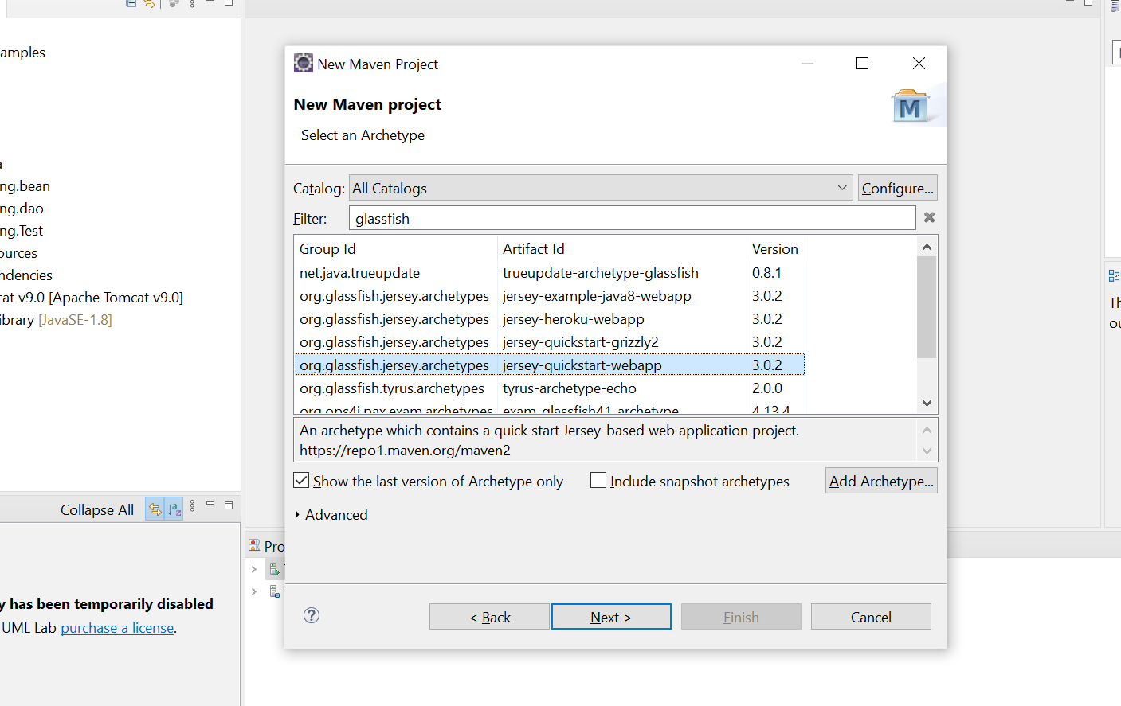
Notes:
<properties>
<jersey.version>3.0.0-M1</jersey.version>
<project.build.sourceEncoding>UTF-8</project.build.sourceEncoding>
</properties>

Slide 11
<?xml version="1.0" encoding="UTF-8"?>
<!-- This web.xml file is not required when using Servlet 3.0 container,
see implementation details http://jersey.java.net/nonav/documentation/latest/jax-rs.html -->
<web-app version="2.5" xmlns="http://java.sun.com/xml/ns/javaee" xmlns:xsi="http://www.w3.org/2001/XMLSchema-instance" xsi:schemaLocation="http://java.sun.com/xml/ns/javaee http://java.sun.com/xml/ns/javaee/web-app_2_5.xsd">
<servlet>
<servlet-name>Jersey Web Application</servlet-name>
<servlet-class>org.glassfish.jersey.servlet.ServletContainer</servlet-class>
<init-param>
<param-name>jersey.config.server.provider.packages</param-name>
<param-value>com.training.Test</param-value>
</init-param>
<load-on-startup>1</load-on-startup>
</servlet>
<servlet-mapping>
<servlet-name>Jersey Web Application</servlet-name>
<url-pattern>/webapi/*</url-pattern>
</servlet-mapping>
</web-app>

Slide 12
@Path("myresource")
public class MyResource {
@GET
@Produces(MediaType.TEXT_PLAIN)
public String getIt() {
return "Got it!";
}
@Path("/hello")
@GET
@Produces(MediaType.TEXT_PLAIN)
public String hello() {
return "Hello World";
}
http://localhost:8080/Test/webapi/myresource
http://localhost:8080/Test/webapi/myresource/hello

Slide 13
http://localhost:8080/Test/webapi/myresource/ok
@GET
@Path("/ok")
public Response getOkResponse() {
String message = "This is a text response";
return Response
.status(Response.Status.OK)
.entity(message)
.build();
}

Slide 14
@Path("/book")
@GET
@Produces(MediaType.APPLICATION_JSON)
public Book getBook()
{
return new Book("8287", "Python", 150.50, 100);
}
<dependency>
<groupId>org.glassfish.jersey.media</groupId>
<artifactId>jersey-media-json-binding</artifactId>
</dependency>

Slide 15
CRUD using collection.
public class BookStore {
private Map<String,Book> books=new HashMap<>();
{
books.put("3456", new Book("3456", "C", 250.25, 100));
books.put("5678", new Book("5678", "CPlus", 250.25, 100));
books.put("3452", new Book("3452", "python", 250.25, 100));
}
public List<Book> getBooks()
{
Collection<Book> set1 = books.values();
return new ArrayList<>(set1);
}
public Book getBook(String isbn)
{
return books.get(isbn);
}
}

Slide 16
Query Param – to read request parameters from query string
@Path("/book1")
@GET
@Produces(MediaType.APPLICATION_JSON)
public Book getBook1(@QueryParam("isbn") String isbn)
{
BookStore store=new BookStore();
return store.getBook(isbn);
}
http://localhost:8080/Test/webapi/myresource/book1?isbn=3452

Slide 17
@PathParam – Sending variables in the path
@Path("/book/isbn/{isbn}")
@GET
@Produces(MediaType.APPLICATION_JSON)
public Book getBook(@PathParam("isbn") String isbn) {
BookStore store=new BookStore();
return store.getBook(isbn);
}
http://localhost:8080/Test/webapi/myresource/book/isbn/3452

Slide 18
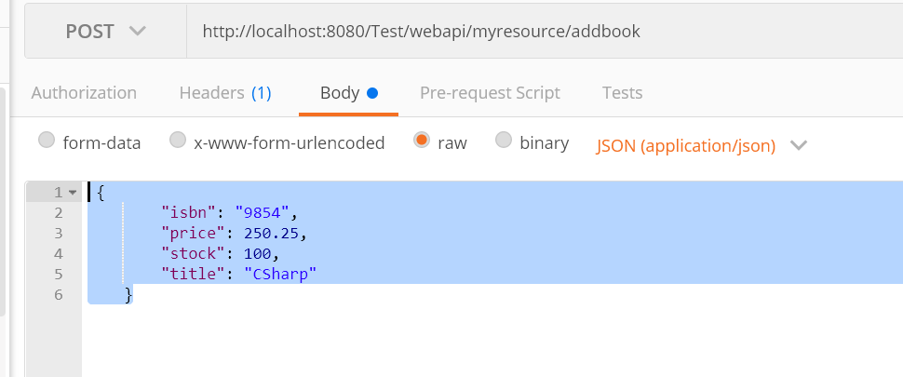
Testing POST method on POSTMAN
@Path("/addbook")
@POST
@Consumes(MediaType.APPLICATION_JSON)
@Produces(MediaType.APPLICATION_JSON)
public Book addBook(Book book)
{
//BookStore store=new BookStore();
return BookStore.addBook(book);}

Slide 19
Testing DELETE method on POSTMAN
@Path("deletebook/isbn/{isbn}")
@DELETE
@Produces(MediaType.APPLICATION_JSON)
public Book delBook(@PathParam("isbn") String isbn)
{
//BookStore store=new BookStore();
return BookStore.delBook(isbn);
}
http://localhost:8080/Test/webapi/myresource/deletebook/isbn/3456
//BookStore.java
public static Book delBook(String isbn)
{
return books.remove(isbn);
}

Slide 20
Testing UPDATE method on POSTMAN
Update Stock of the Book based on isbn.

Slide 21
Database connectivity
public class BookDao implements BookDaoI{
private Connection connection;
{
try {
Class.forName("com.mysql.cj.jdbc.Driver");//1
connection = DriverManager.getConnection("jdbc:mysql://localhost:3306/training","root","root");
if(connection != null)
{
System.out.println("Connection done...");
}
} catch (ClassNotFoundException | SQLException e) {
e.printStackTrace();
}
<dependency>
<groupId>mysql</groupId>
<artifactId>mysql-connector-java</artifactId>
<version>8.0.21</version>
</dependency>

Slide 22
Reading from a properties file
public static final String PROPERTIES_FILE = "config.properties";
public static Properties properties = new Properties();
private Properties readProperties() {
InputStream inputStream = getClass().getClassLoader().getResourceAsStream(PROPERTIES_FILE);
if (inputStream != null) {
try {
properties.load(inputStream);
} catch (IOException e) {
// TODO Add your custom fail-over code here
e.printStackTrace();
}
}
return properties;
}

